Slide 1
AI-Powered Inventory Locator System
Demystifying AI: Thomas Burns, Lalitsingh Rawat, and Peggy Schwander
Notes:
Thomas

Slide 2
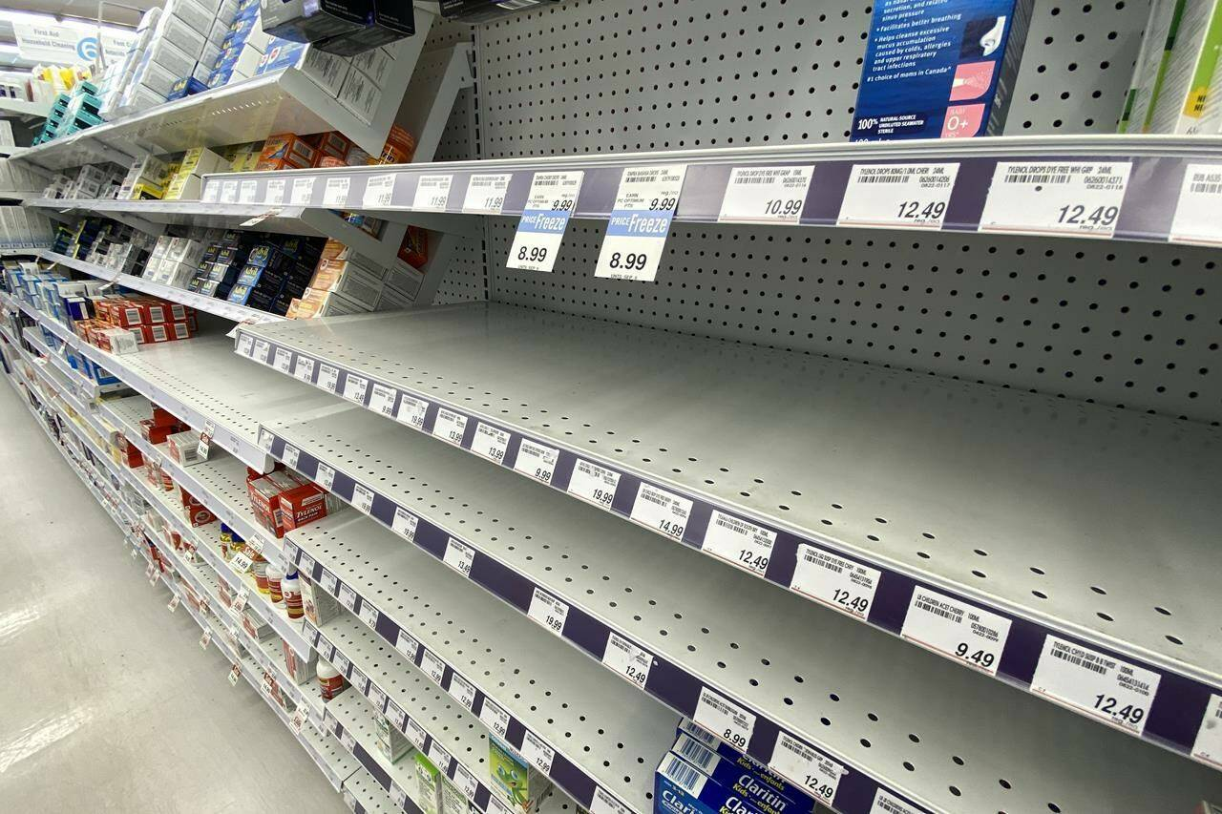
The Problem
Imagine for a moment…
Notes:
Thomas

Slide 3
Inventory Locator Overview
AI-powered system that identifies a product from an uploaded photo and retrieves real-time availability from retailers.
Designed to reduce out-of-stock frustration and streamline shopping decisions through an automated pipeline.
Extracts text via Google Cloud Vision OCR, transforms the text into structured input for multi-step product lookup.
Uses SerpAPI Google Shopping → Immersive Product API to surface nearby vs online availability.

Slide 4
User Journey
User uploads an image; backend validates format and processes it through Google OCR.
System performs Google Shopping search to retrieve top product matches.
User selecting a product triggers a detailed lookup of store-level and online availability.
UI displays results with pricing, pickup options, and retailer links.
Notes:
Peggy
Google OCR refers to Google Cloud Vision’s Optical Character Recognition (OCR) service.
It takes an uploaded photo of a shelf label, and extracts the text from it. This is a deterministic process, meaning the same image will always produce the same text output. It gives us clean, structured text that we can use as the search query for the next step of our system.
Uses smart filtering to extract ONLY the product name, removing all prices, barcodes, and other junk.

Slide 5
Google OCR Flowchart
Input Document (Image/PDF/Scan)
↓
Upload to Google Cloud Vision OCR
↓
Preprocessing (Noise Removal, Enhancement, Rotation)
↓
Text Detection (Characters, Words, Paragraphs)
↓
Recognition Engine (Unicode Conversion, Language Model, Confidence Scoring)
↓
Post Processing (Layout Reconstruction, Entity Extraction, Formatting)
↓
Output Results (JSON / Text / Structured Data)
Notes:
The OCR process is typically divided into three main stages:
Preprocessing & Detection: Cleaning the image (deskewing, noise reduction) and locating text regions (lines, words, characters).
Recognition (The Engine): The machine learning model that classifies each visual pattern into a character.
Post-Processing & Output: Correcting errors and formatting the final text.
Unicode is the international standard for the encoding, representation, and handling of text expressed in most of the world's writing systems.
Role in OCR: The Recognition Engine's final output must be in a universally understood format so that the text can be displayed, searched, and edited by any software program globally.

Slide 6
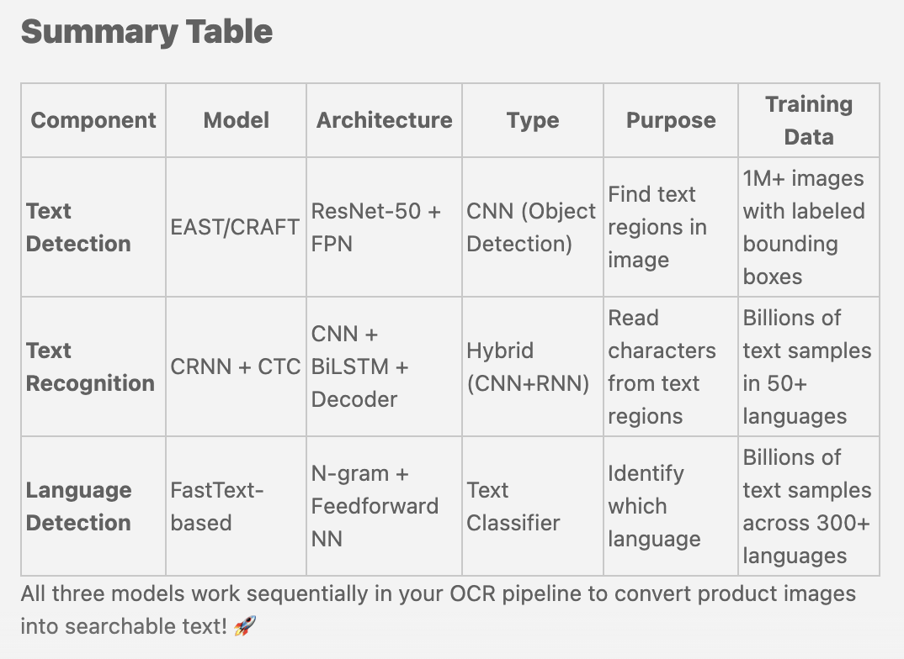
OCR Models
Notes:
Model Name
EAST (Efficient and Accurate Scene Text Detector) - Modified Google version
Type
Deep Convolutional Neural Network (CNN)
Model Name
CRNN (Convolutional Recurrent Neural Network) with CTC decoder
Google's proprietary version: Enhanced with Attention Mechanism
N-gram Language Model with Neural Network Classifier
FastText-based language identifier (Facebook's architecture, adapted by Google)

Slide 7
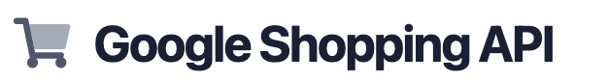
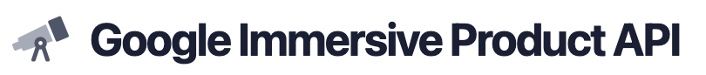
SerpAPI
Searches for product matching the uploaded image and returns top matches with:
Provides product tokens needed to retrieve detailed store availability
Pricing, ratings, retailer information
*Does not contain location availability
Retrieves detailed store-level data for a selected product, including:
Nearby vs. online availability
Pricing across retailers
Pickup/shipping options to help users find in-stock products near their location.
Notes:
Lalit

Slide 8
System Architecture
backend
docs
models
scripts
tests
ui
.env.example
.gitignore
Dockerfile
Quickstart.md
README.md
requirements.txt
docker-compose.yml
System Configurations
Notes:
Thomas

Slide 9
Demystifying the AI
OCR is deterministic text extraction—not generative—making results transparent and explainable
SerpAPI connects product text to real-world listings through structured metadata from Google results
Immersive Product API enriches results with store availability, shipping, pricing, and nearby indicators
Ranking uses clear rule-based logic so outcomes are fully interpretable
Notes:
Peggy
1Google OCR refers to Google Cloud Vision’s Optical Character Recognition (OCR) service.
* We didn’t use YOLO for this implementation. Our goal for this course was to build a transparent, explainable pipeline, so we focused on OCR for text extraction and API based data retrieval rather than full image-object detection.
2SerpAPI, which essentially performs a structured Google Shopping search. Instead of scraping a web page, we receive clean metadata: titles, prices, thumbnails, ratings, and the immersive product tokens. This step transforms the OCR text into real product candidates in the marketplace.
3When the user selects a product, we use the immersive product token to call the Immersive Product API. This provides store-level detail: things like pickup availability, ‘in stock nearby’ flags, shipping options, pricing, and retailer links. This is the part of the pipeline that tells us not just what the product is, but where the user can actually get it.
4Ranking uses rule-based logic, meaning the app follows explicit, transparent rules to decide whether a store is classified as Nearby or Online. Because the rules are simple and visible, anyone can understand exactly why a store appears in each category.

Slide 10
Impact & Future Directions
Immediate value
Quick identification and availability insights based on a simple photo
Strengths
Limitations
Future Enhancements
Modular design
Docker environment
Transparent logic
OCR quality varies by image and product label
Availability metadata depends on external (free) APIs
Image Segmentation
Barcode fallback
Production deployment
Notes:
Thomas

Slide 11
Sources
Google Cloud Vision Optical Character Recognition (OCR)
SerpAPI Google Shopping API
SerpAPI Immersive Product API

